Slide 1
A Case Study on Global Knowledge Exchange with a Library-Published Journal
Christopher Hollister | University at Buffalo | cvh2@buffalo.edu

Slide 2
Case study overview…
A library-published, scholarly journal
Background
Global exchange
Philosophy
Experience
Successes
Challenges
Professional discourse
Research/literature
Potential solutions

Slide 3
Communications in Information Literacy (CIL)
Independent , library-published, scholarly journal
Peer-reviewed
Open access (diamond, platinum, etc.)
Purview: IL in higher education
2007–present (v. 1–13); semiannual
Cabell’s, Clarivate, DOAJ, Ebsco, ERIC, Elsevier, Google Scholar, Library of Congress, ProQuest, Public Knowledge Project, Ulrichsweb, etc.

Slide 4
Online Journal Systems: 2007-2017 (University at Buffalo)
Digital Commons: 2017-present (Portland State University)

Slide 6
2018 SJR Score: 1.657, 6/226 Library and Information Science (Scopus ®)

Slide 7
“Values-driven publishing” (Hoops & Hare, 2019)
Unfettered open access
Independent/unaffiliated editorship
Mentorship for new authors and reviewers
Diversity/inclusiveness
Global representation
Eco-friendly practices

Slide 8
International IL research…
Valdunciel, M. (2018). Alfabetización informacional y biblioteca neoliberal: Hacia un nuevo paradigma. Informacion, Cultura y Sociedad, 39, 129–138.
Özel, N. (2014). Araştırma Görevlilerinin Bilgi Okuryazarlığı Becerileri ve Eğitim Gereksinimleri: Ankara Üniversitesi Örneği. Information World / Bilgi Dunyasi, 15(2), 253–283.
Sonia, Š. (2013). Az információs mûveltség változó szempontjai a 2.0-ás kutatási környezetben. Library Review / Konyvtari Figyelo, 23(2), 332–342.
Kibler, S. (2017). Informationskompetenzvermittlung gemeinsam gestalten: hochschulinterne Kooperationen anbahnen und durchführen. Bibliotheksdienst, 51(12), 1009–1022.
León-Moreno, J., & Caldera-Serrano, J. (2013). Códigos QR en las bibliotecas. Ciencias de La Información, 44(1), 22.
Vyčítalová, A. (2012). Informační gramotnost ve zdravotnictví se zamĕřením na rozvoj informační gramotnosti pacientů. Knihovna, 23(2), 5–21.
Erich, A., & Popescu, C. (2012). Cultura informaţiei - o nouă abordare în sprijinul dezvoltării abilităţilor didactice. Library & Information Science Research, 16, 126–139.
Dreisiebner, S., & Mandl, T. (2017). Entwicklung und Evaluierung einer Plattform zur Vermittlung von Informtionskompetenz: Vorstellung des von der Europäischen Union geförderten Projekts "Information Literacy Online". Bibliotheksdienst, 51(9), 763–770.
Lasić-Lazić, J., Špiranec, S., & Zorica, M. B. (2012). Izgubljeni u novim obrazovnim okruženjima - pronadeni u informacijskom opismenjivanju. Medijska Istrazivanja/Media Research, 18(1), 125–142.
Renditiso, A. (2011). L’information literacy nelle biblioteche universitarie italiane: i risultati di un’indagine comparati con le modalità di comunicazione del servizio sul Web. Bollettino AIB, 51(3), 213–226.
Zikuška, J., & Güntherová, E. (2009). Partnerství a spolupráce -- NAKLIV (Národní klastr informačního vzdĕlávání). Knihovna, 20(2), 63–67.

Slide 9
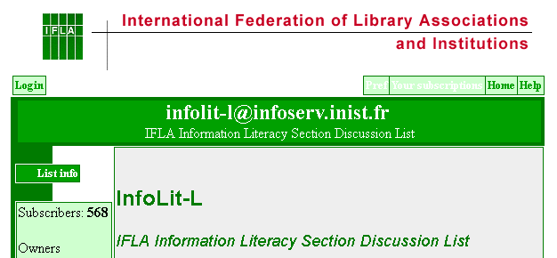
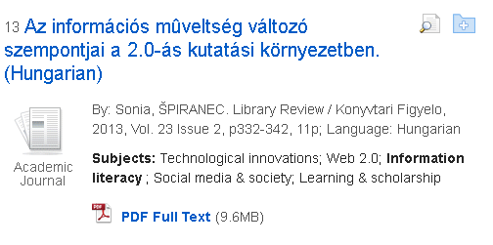
Soliciting across borders…

Slide 10
International submissions…
Australia
Brazil
Canada
China
Colombia
Cyprus
Denmark
Ecuador
Ghana
Hong Kong
Hungary
India
Indonesia
Iran
Ireland
Israel
Kuwait
Netherlands
New Zealand
Niger
Nigeria
Norway
Pakistan
Philippines
Portugal
Puerto Rico
Qatar
Russia
Saudi Arabia
Senegal
Singapore
Spain
Sri Lanka
Taiwan
Thailand
Trinidad and Tobago
Turkey
United Arab Emirates
United Kingdom
United States

Slide 12
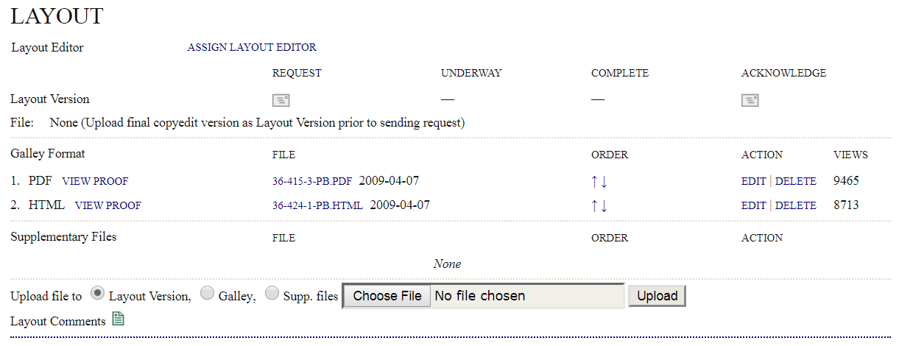
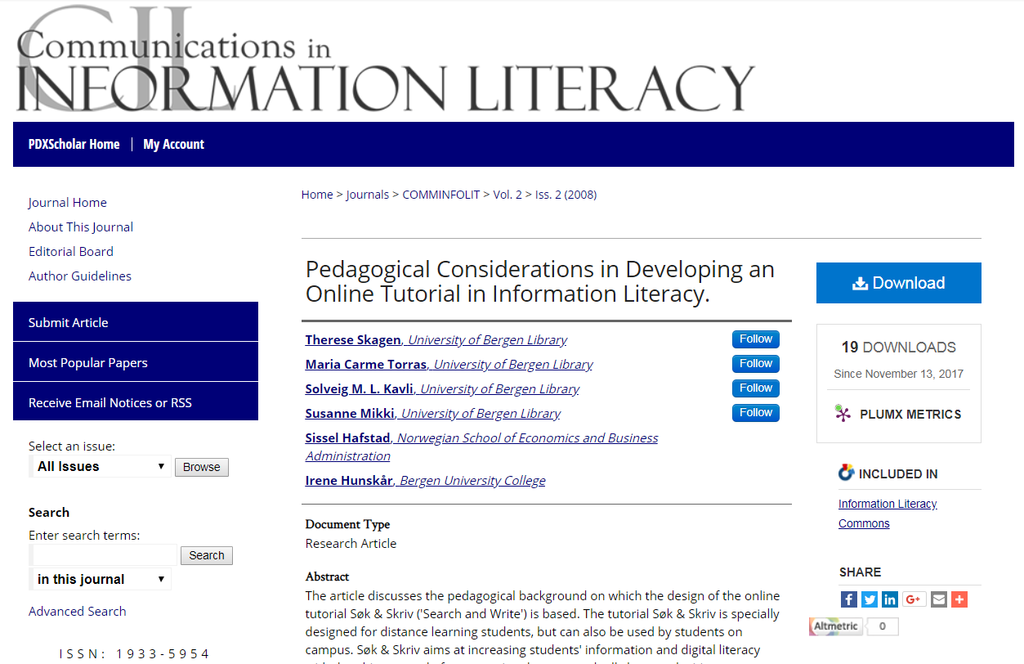
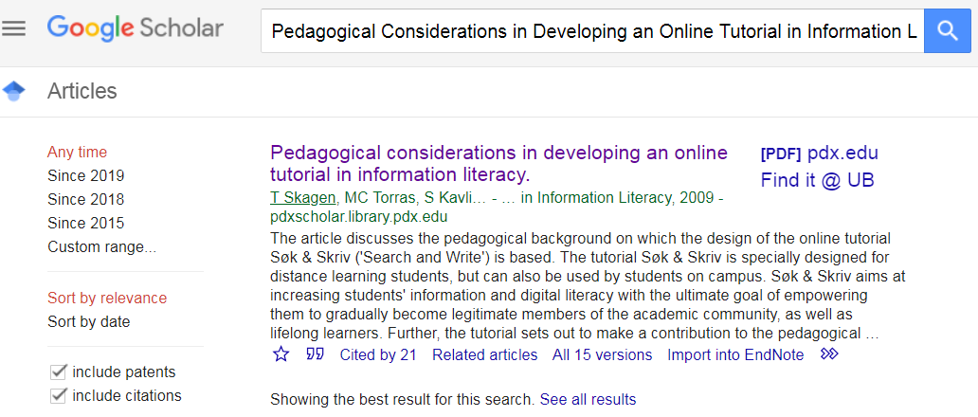
Publishing across borders…

Slide 13
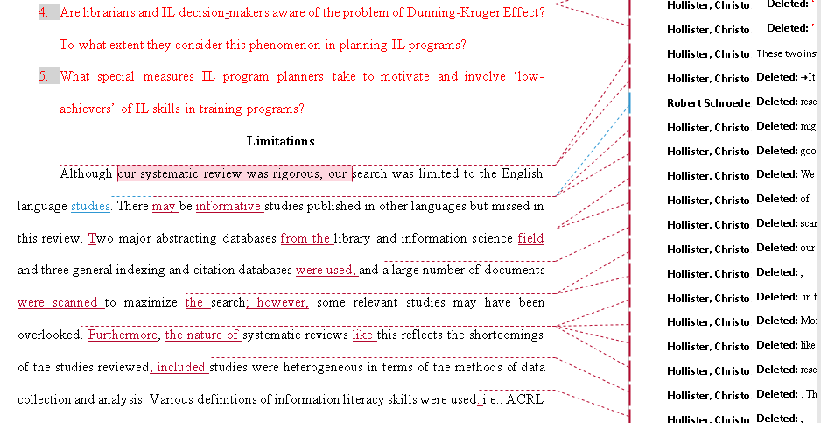

Slide 14
Kaplan & Baldauf (2005)…
Examples of misrepresentation of the research of other scholars
Extensive repetition
Lack of effective parallelism
Peculiar word choice
Contradictions across large texts
Descriptions of situations in a given polity without noticing that the particular situation is
Widespread across many polities
Leaps from the specific to the general
Inclusion of irrelevant material
Problem oversimplification
Lack of evidence
Over/under estimation
Insufficient discussion of important elements
Over/under assumption of audience knowledge
And so on…

Slide 15
Mišak, Marušić, & Marušić (2005)…
“…specialized translators may contribute to the quality of a paper by assuming the role of critical readers or language reviewers and act as authors’ editors.”

Slide 16
Flowerdew (2008)…
“…results in an unnecessary impoverishment of global knowledge, because contributions from [non-native English] writers may go unrecognized.”
“English belongs to everyone and this includes the particular disciplinary communities, which have their own particular varieties of the language.”
“This means that what is acceptable to the disciplinary community is up to the members of that community [regardless of native language]. Perhaps editors should therefore be encouraged to accept forms of English which, as long as they are intelligible, may not conform to ‘standard English’.”

Slide 17
Global exchange option A…
Library Publishing Coalition
IFLA: SIG on Library Publishing
[Vendors?]
International disciplinary
repository
Library publishers?

Slide 18
Global exchange option B…
Vendors (bepress, Ebsco)
Library Publishing Coalition
Translation, editing, processing services
IFLA: SIG on Library Publishing
Library publishers

Slide 19
References…
Flowerdew, J. (2008). Scholarly writers who use English as an additional language: What can Goffman’s “Stigma” tell us? Journal of English for Academic Purposes, 7(2), 77-86.
Hoops, J., & Hare, S. (2019). Library publisher resources: Making publishing approachable, sustainable, and values-driven. College & Research Libraries News, 80(2), 74-77.
Kaplan, R., & Baldauf, R. (2005). Editing contributed scholarly articles from a language management perspective. Journal of Second Language Writing, 14(1), 47-62.
Mišak, A., Marušić, M., & Marušić, A. (2005). Manuscript editing as a way of teaching academic writing: Experience from a small scientific journal. Journal of Second Language Writing, 14,(2) 122-131.

Slide 20
Go raibh maith agat 감사합니다 Merci شكرا ありがとう Dziękuję Ci धन्यवाद ευχαριστώ Grazie Cпасибо Thank you ☺

