Slide 1
Library
Awesome
Sauce
Undergraduate
Research
Student-Led Research and Student-Centric Publishing
Phillip Fitzsimmons, phillip.fitzsimmons@swosu.edu
Hector Lucas, lucash@student.swosu.edu
Jeremy Evert, jeremy.evert@swosu.edu
Notes:
It is on topic to give a shout out to all of the SWOSU students and faculty who participated in our Research and Scholarly Activity Fair.

Slide 2
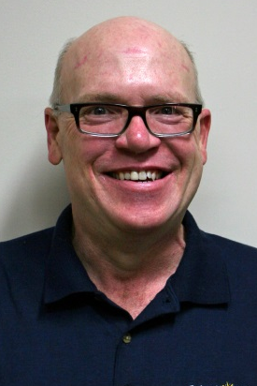
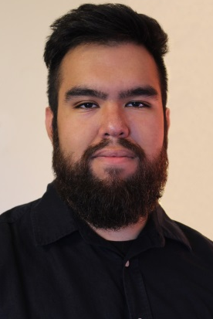
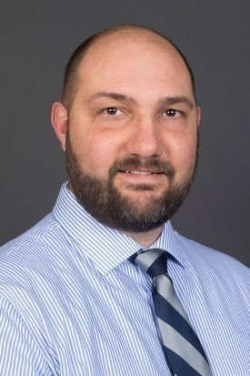
Phillip Fitzsimmons, MLIS, Tenure-Track Faculty, Reference and Digitization Librarian, Al Harris Library. Liaison to the Engineering Technology Department.
Hector Lucas, a Communication Arts junior from Ringwood, OK, videographed interviews with software engineering students. Those videos are featured on SWOSU Digital Commons.
Jeremy Evert, Ph.D. Tenure-Track Faculty, Computer Science and Engineering Technology. Faculty for Software Engineering and Undergraduate Research.

Slide 3
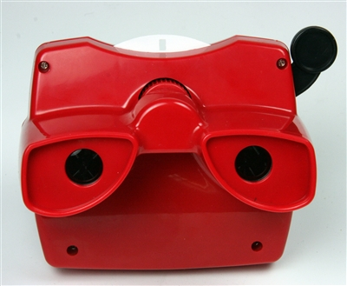
First, Phillip will discuss our subject from an archivist’s perspective.

Slide 4
Outmoded thinking!
Library =
Notes:
Library stereotypes are familiar, even if you don't believe them yourself. Too many people still think of libraries this way. Even college students often view academic libraries as just a bigger version of their middle school libraries.

Slide 5
When in reality …
Notes:
But we know that libraries are much more than a place to check out books. They are information centers, of items in multiple formats, with equipment to use, and staffed by professionals who are eager to help students and faculty make their projects happen. Our emphases today is on “student lead” or “student-centric” research projects that the SWOSU Libraries are assisting in making their research available to the world.

Slide 6
Let’s talk …
Every discipline is a great, ongoing, and international conversation. This is true whether a work is from the hard or soft sciences, the humanities, or the creative arts. Scholars are the people who contribute to the conversations of their fields. An institutional repository is a tool that scholars can use to participate in the great conversations of their respective disciplines.

Slide 7
Serving our community…
4-Year, Regional University
15 Nationally-Accredited Academic Programs
200+ Faculty
Student FTE 4,500
Signature Programs:
Pharmacy
Nursing
Education
Computer Science
Engineering Technology
Notable activities
Robotics Competitions
NASA Moonbuggy Competitions
NASA Center Internships
7 Faculty Librarians, 8 Staff, 15 Student Workers
Services: Virtual Reference Services, Instruction, Circulation Services, Digitization, Interlibrary Loan
Tech-specific services: Equipment in-house and in circulation: PCs, Laptops, Cameras, GoPros, Video equipment, Digital recorders, External HDs, USBs, audio recorders, headphones, graphic calculators, software
Unique Tech Spaces:
Media Studio (video cameras, a green screen, a teleprompter, editing bays and other advanced A/V tools)
Huddle Room (wall-to-wall dry erase boards, a collaboration table with a PC and large monitor, a webcam for online conferencing, and seating for small groups)
Media Creation Room (book scanner, equipment for changing video and audio formats)
Notes:
Before we get into too much detail, let's take a step back and take an overall look at SWOSU Libraries.

Slide 8
Institutional Repository & Open Access Journal Publishing
SWOSU DIGITAL COMMONS
Hosts 3 SWOSU OA Journals:
Administrative Issues Journal (AIJ)
Journal of Undergraduate Research
Westview: A Journal of Western Oklahoma
Hosts Faculty and Student Research

Slide 9
Supporting student research and creative works …
Notes:
The Software Engineering Video project is one example of how the SWOSU Libraries has been successful in helping students and faculty make full use of our services for their research and scholarly activities, including disseminating their work. All of the points in the slide are carried out, in part, by our Institutional Repository (IR) services. And research shows that this type of promotion and encouragement of student research is an important partner in the college's academic mission.

Slide 10
Westview
is published semiannually by the Language Arts Department at SWOSU. Publications include previously unpublished short fiction, poetry, prose poems, creative nonfiction, and artwork.

Slide 11
The Southwestern
is SWOSU’s student newspaper and is published weekly during the fall and spring semesters, except during holidays and finals week. Students in the editing class serve as section editors, and students in the news gathering and reporting class serve as writers.

Slide 12
SWOSU ESL Club Newsletter actually provides a printed voice for two clubs: the SWOSU ESL Club and the Women Speak Organization. Publication on SWOSU’s Digital Commons means the international-student staff – not to mention their families – can access the newsletter anywhere the Internet reaches.

Slide 13
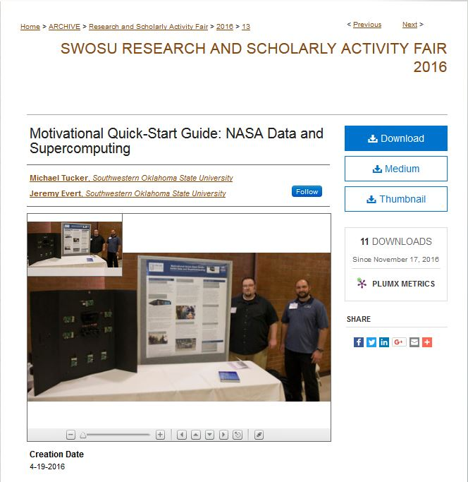
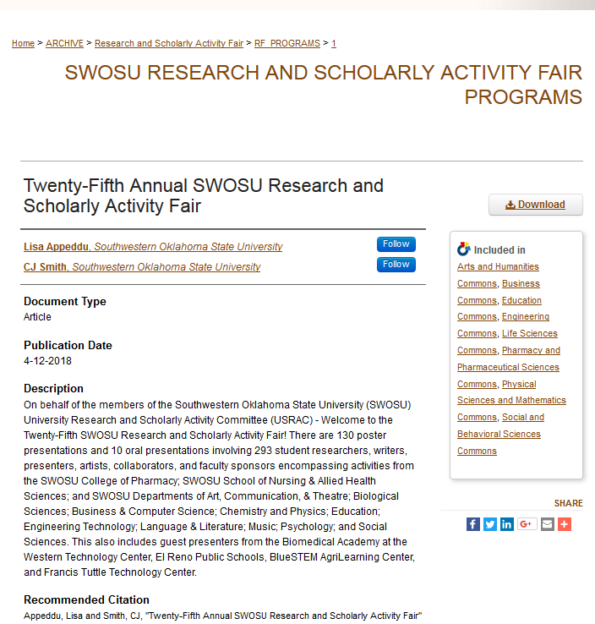
Promoting undergraduate student researchers …
Research and Scholarly Activity Fair
Notes:
Next look at how the repository is a gateway for a global audience. We will look at just one article. Start with 2016 Student Research and Scholarly Activity Fair. Here is one article by a group of student researchers. The platform makes the article available worldwide (explain how people around the world can search for it), with live updates of its use by others. This shows how many times the article was downloaded, this is the live dashboard showing locations of access, and here is a notice that a person in Menlo Park is downloading this very article by SWOSU students.

Slide 14
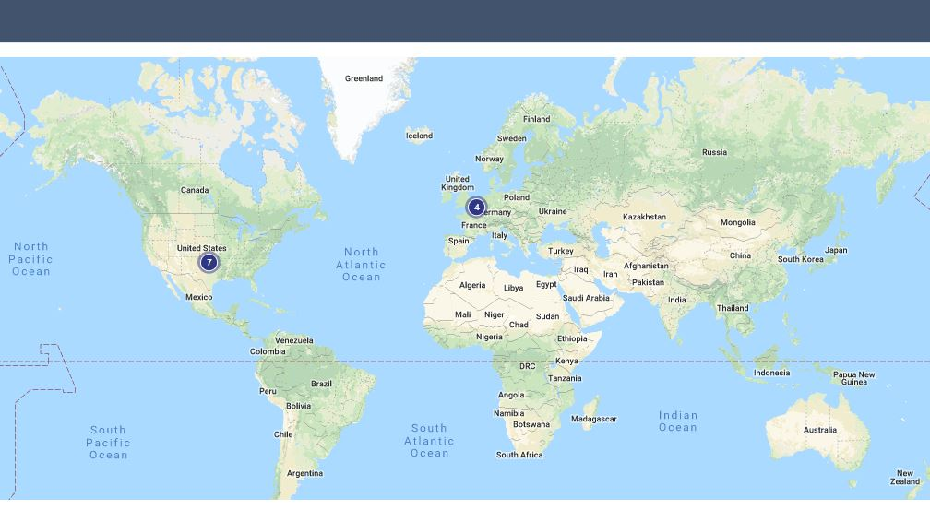
An example of usage statistics reports
Chart showing number of downloads
Dashboard map shows geographic location of downloads.

Slide 15
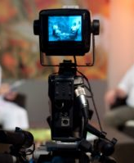
Now Hector will talk about the experience from his perspective as a student.

Slide 16
A platform for student-led research …
Student-produced computer science videos
Notes:
First discuss Hector Lucas and his podcasts, which is both a form of student creative works and chronicles other students' research:
https://dc.swosu.edu/cp_videos/6/ - Noah Camp, https://dc.swosu.edu/cp_videos/2/ - Adam Fuller, https://dc.swosu.edu/cp_videos/4/ - Jordyn Hartzell, https://dc.swosu.edu/cp_videos/5/ - Marc Martinez, https://dc.swosu.edu/cp_videos/7/ - Sweksha Poudel, https://dc.swosu.edu/cp_videos/3/ - Aditi Shrestha
Has already had 29 views.

Slide 17
Now, Jeremy will look at our topic from the perspective of a research faculty.

Slide 18
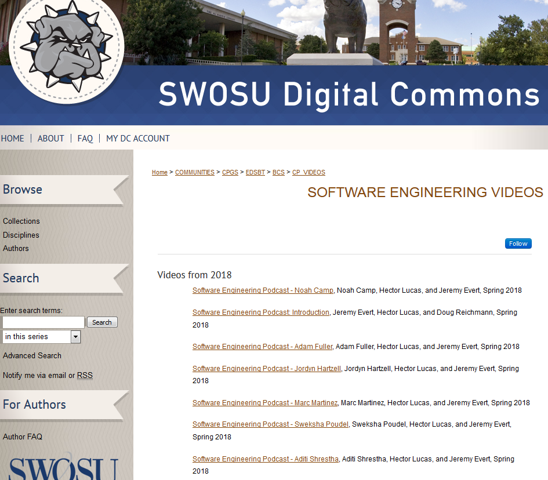
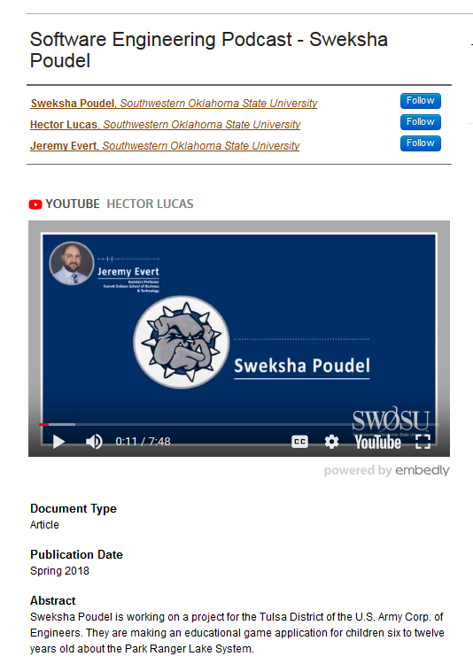
A platform for student-led research …
Student-produced computer science videos
Notes:
First discuss Hector Lucas and his podcasts, which is both a form of student creative works and chronicles other students' research:
https://dc.swosu.edu/cp_videos/6/ - Noah Camp, https://dc.swosu.edu/cp_videos/2/ - Adam Fuller, https://dc.swosu.edu/cp_videos/4/ - Jordyn Hartzell, https://dc.swosu.edu/cp_videos/5/ - Marc Martinez, https://dc.swosu.edu/cp_videos/7/ - Sweksha Poudel, https://dc.swosu.edu/cp_videos/3/ - Aditi Shrestha
Has already had 29 views.

Slide 19
Laying the foundation
SWOSU Journal of Undergraduate Research
SWOSU Libraries provides hosting for the Journal.
Archivist accommodates publishing to the schedules of student researchers.
Publishing is part of what an Archivist does as regular business.
Publishing also serves as an end reward for the faculty to motivate students.
After the journal is complete, the Archivist completes the process for publication, including posting online and providing links to the articles.
Publication means students can include live links to their research on resumes, personal web sites, and social media.
Notes:
The Software Engineering Video project is one example of how the SWOSU Libraries has been successful in helping students and faculty make full use of our services for their research and scholarly activities, including disseminating their work. All of the points in the slide are carried out, in part, by our Institutional Repository (IR) services. And research shows that this type of promotion and encouragement of student research is an important partner in the college's academic mission.

Slide 20
Promoting undergraduate student researchers …
Research and Scholarly Activity Fair
Notes:
Next look at how the repository is a gateway for a global audience. We will look at just one article. Start with 2016 Student Research and Scholarly Activity Fair. Here is one article by a group of student researchers. The platform makes the article available worldwide (explain how people around the world can search for it), with live updates of its use by others. This shows how many times the article was downloaded, this is the live dashboard showing locations of access, and here is a notice that a person in Menlo Park is downloading this very article by SWOSU students.

Slide 21
For the students
Students experience their first publication.
Live links make their findings public on a global level.
Worldwide access makes the student researcher feel his/her accomplishment is significant.
Student researchers can learn about work by their peers.
Students can learn from others’ examples.

Slide 22
For the faculty and the institution
Student-led research and student-centric publishing:
Provides support for future research grants.
Allows networking with other researchers.
Motivates other researchers to join the process.

Slide 23
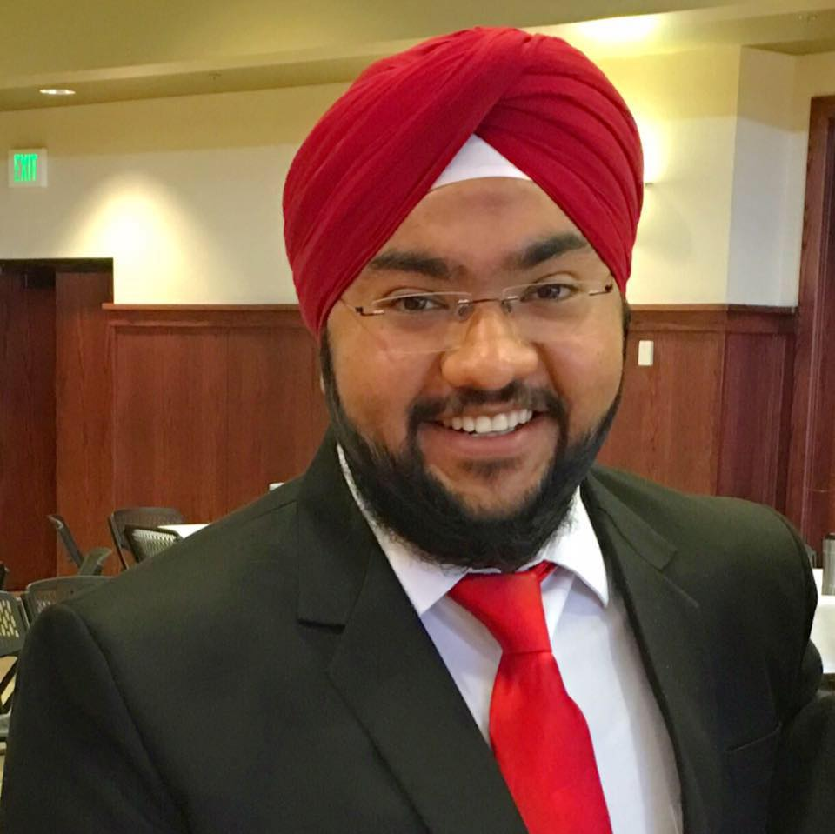
Student Success Story #1
Prabhjyot Saluja earned a degree in computer science from SWOSU in 2017. While at SWOSU he completed an internship with Blue Waters National Center for Super Computer Applications. His research done as part of his internship was published on SWOSU Digital Commons:
Computational Molecular Modeling – Solving Quantum Mechanics Based Calculations Concerning Molecular Properties and Structures
Today he works as a HPC Systems Administrator at Purdue University.

Slide 24
Student Success Story #2
Aditi Shrestha will graduate from SWOSU in 2019 with a degree in computer science. Her team research on software engineering was featured in a video on SWOSU Digital Commons:
Third Round Software Engineering Interview - #1

Slide 25
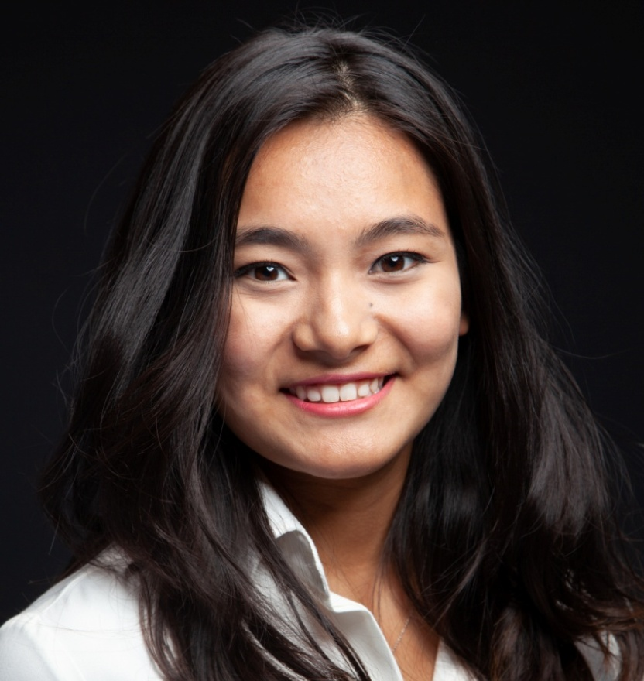
Student Success Story #2, continued
Her work at SWOSU helped her land a prestigious summer internship in parallel computational science with the National Center for Atmospheric Research in Boulder, CO. There she researched Creating a Jupyter Notebook Kernel for NCL, which is featured on the web site of the Computational and Informational Systems Lab of NCAR.

Slide 26
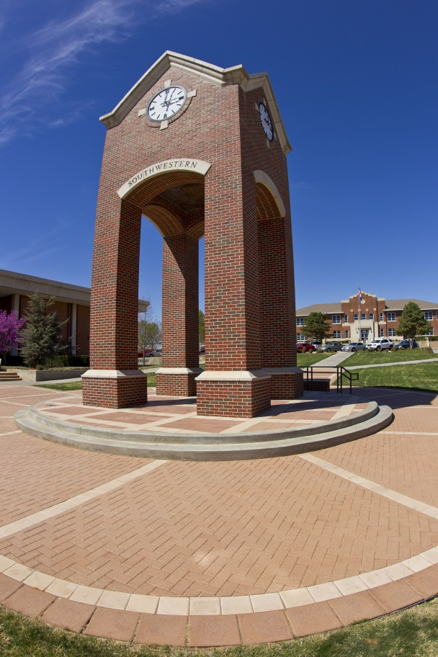
Student-Led Research and Student-Centric Publishing
Contributes to course learning outcomes
Promotes undergraduate success
Integrates with campus strategic plan
Makes a global impact

Slide 27
Scholarly work, not just homework
Remember, it isn’t just homework anymore once a work has been posted to an institutional repository. The student’s research becomes a permanent contribution to the great conversation of the scholar’s or artist’s field, and that work can be seen by anyone with a computer and the Internet.

Slide 28
QUESTIONS?
Contact information:
Phillip Fitzsimmons, phillip.fitzsimmons@swosu.edu
Hector Lucas, lucash@student.swosu.edu
Jeremy Evert, jeremy.evert@swosu.edu
info@bepress.com

Slide 29
Credits for images not from SWOSU or Microsoft:
Raspberries in cup: https://www.maxpixel.net/Red-Raspberries-Cup-Berries-Food-Dessert-Fruit-423194
Shushing librarian: http://mediaspecialistsguide.blogspot.com/2014/05/throwback-thursday-13-shhh.html
Keep calm and ask -- http://twulibraries.blogspot.com/2012/08/the-newest-way-to-keep-calm-and-ask.html
Viewfinder -- https://www.worldwideslides.com/3D-Reel-ViewFinder-TM-Focusing-Viewer-p/vvn-rnr.htm
Video camera -- https://epicpresence.com/earned-media/7602132-video-camera-viewfinder-recording-show-in-tv-studio/
Magnifying glass/research -- http://enil.eu/news/introducing-enils-independent-living-research-network/
Aditi Shrestha -- https://www2.cisl.ucar.edu/siparcs-2018-aditi-shrestha

