Slide 1
Data Privacy by Design
Expanding Security for bepress Users
Jenelys Cox, MLIS
Institutional Repository Manager & Application Support Technician
University of Denver
Nicole Johnson
Product Manager, Digital Commons
bepress

Slide 2
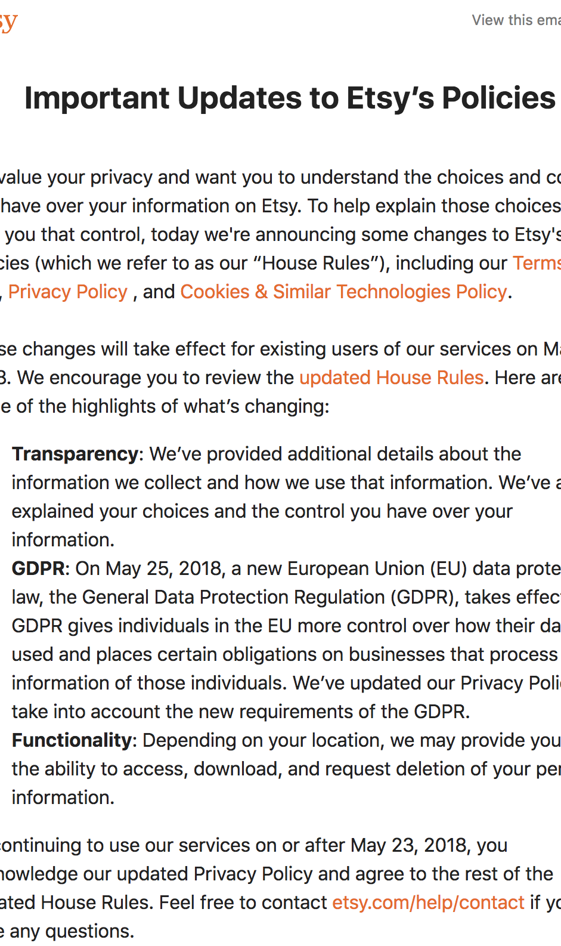
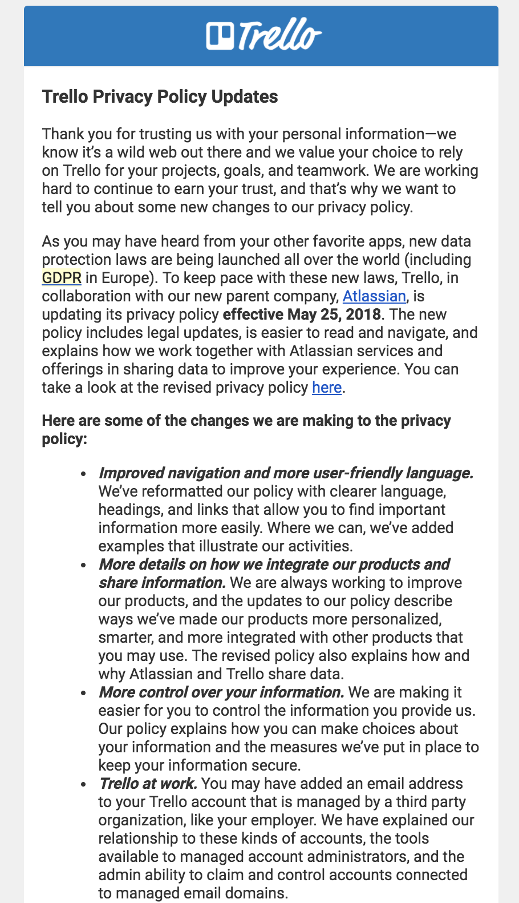
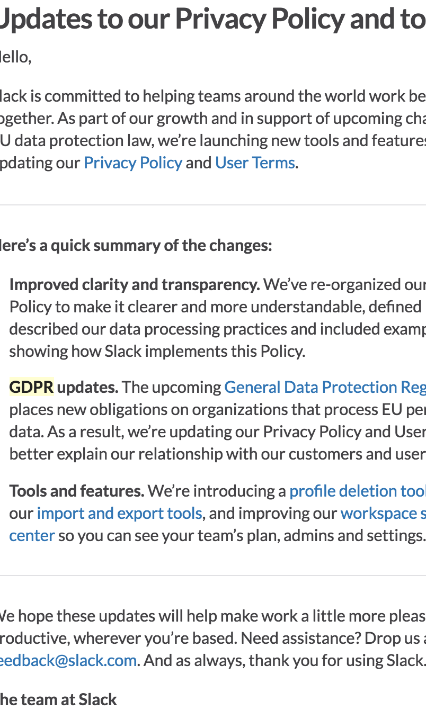
"Updates to our Privacy Policy"

Slide 3
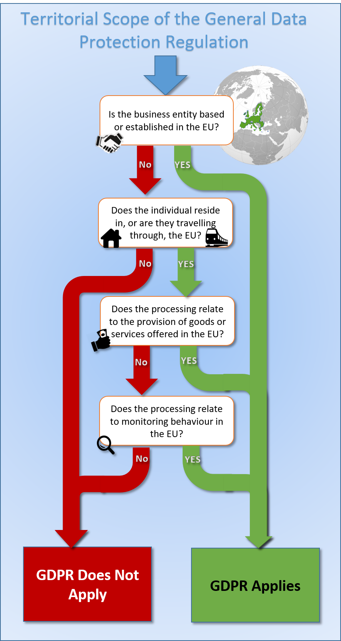
What is GDPR?
EU: General Data Protection Regulation (GDPR) ​
Goes into effect on May 25
Aims to harmonize privacy rules across the EU​
Bringing data protection into the 21st century​
Will apply to all countries of the EU (incl. UK)​

Slide 4
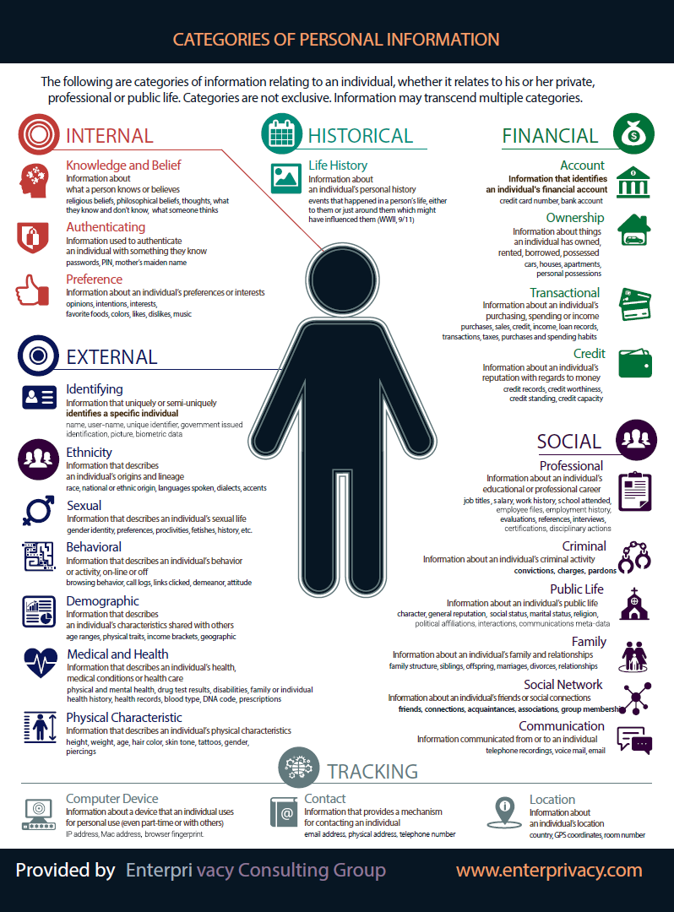
Background and Basics
Applies when controller (determines purpose and means), processor or subject in EU country
Personal data is any information relating to an identified or identifiable natural person

Slide 5
GDPR Key attention areas (1)
Data Privacy Register: organizations must maintain records of data processing activities
stating: purposes, categories of data, categories of recipients, security measures, legal basis, etc.
regulators can ask for access to validate
Data Subject Rights: right to access, to rectify, and to erase, and right for data portability
Privacy-by-Design: all developments have to demonstrate that privacy is taken into account
data minimization, retention actioned, etc.

Slide 6
GDPR Key attention areas (2)
Consent: an affirmative action, freely given, specific, informed and unambiguous
Privacy policy: there is a list of what must be provided in a privacy notice / statement
Breaches: report high-risk breaches within 72 hours; notify data subjects if high risk to them
Security: pseudonymization, encryption, access restriction, availability, integrity, restore, etc.
Text: www.privacy-regulation.eu/en/
Guide: ico.org.uk/for-organisations/

Slide 7
GDPR framework is an opportunity!
Governance: GDPR compliance provides a standard framework to introduce strong data governance across your organization.
Minimize Risk: GDPR compliance will ensure that the risk of high-impact breaches and other data problems is significantly reduced.
Trust: GDPR compliance will demonstrate to your users that they can trust your organization to safeguard and to use their personal data properly and responsibly.

Slide 8
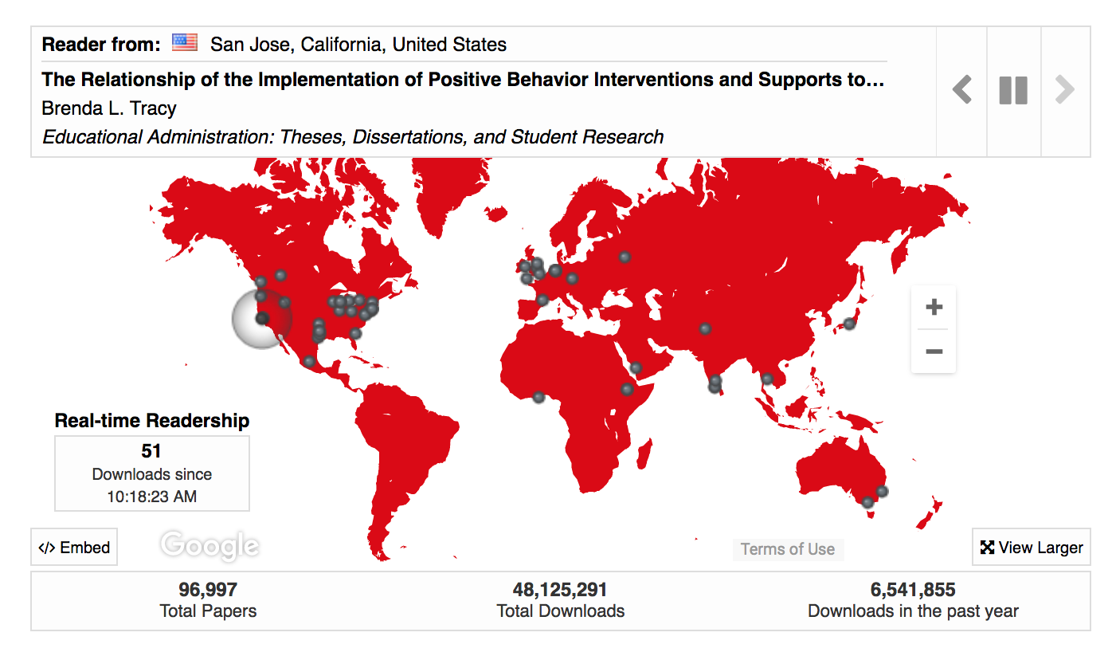
So, what about the IR?
Global impact, local offerings.
Any vendor or 3rd party you engage with should be assessed for compliance.
Know: who is the processor and who is the controller? (bepress is both!)

Slide 9
How GDPR can help
Ease conversations with stakeholders and end users
Open the door to knowledge-sharing opportunities:
Re-engage constituents
Provide a framework to assess vendors
Privacy-by-Design allows products and customers to manage expectations and assess value of feature versus implications for privacy

Slide 10
bepress and GDPR
GDPR teams in different business units
Technology, legal and privacy specialists, project managers, product owners, communications
Inventory of systems, owners, and PD status
Developing EU clarity and guidance
Published vs. non-published information
Centrally stored vs. copied and duplicated
Stringent Privacy-by-Design development
Appropriate format of SAR requests
Informational Privacy Policies
Process
Data Privacy Register and PD inventory
Translated GDPR demands into questionnaire
Business, Technology, Security
Review with experts to identify gaps
Create and execute GDPR remediation plans
Address
Assess PD inventory: necessary and valuable only
Assess any places where we can improve infrastructure
Privacy-by-Design

Slide 11
Privacy and Library Policies

Slide 12
Where We Are @ DU
Campus IT has been looking into GDPR compliance
Vendor products
Home-grown products
Library is just getting started
Form a task force
Data audit
Rewrite our privacy policies
Make those polices easily accessible
Natural language
Easy to find

Slide 13
Considerations
Broad Scope (Policy)
Narrow Scope (Data audit)
Transparency
Do patrons know we have data?
Autonomy
Can patrons choose what data they give us?
Security
Are the platforms we're using adequate to protect patron privacy?
What do we collect?
Patron accounts
Proxies, websites, chat records, & logs
Usability, student success, & library use
Why do we collect it?
Necessary for operation
"Improving Services"
Is it justified?
Do we actually need it?
Do we need to keep it? How long?

Slide 14
Privacy Policies
Addressing Transparency
State what we collect, why, and how long we keep it
State what our policy covers
Make it obvious we don't control our vendors
Addressing Autonomy
If data is not necessary to basic operation, allow opt-in/out
Easy & obvious for the patron, with an explanation of what may be affected
May require scripts, workarounds, or recoding
Addressing Security
Have a stated procedure for breaches
Contact all appropriate parties (Patron, Campus IT Security, Vendor, Others)

Slide 15
Thank you! Questions?
Njohnson@bepress.com

