Slide 1
Best Practices for Electronic Theses and Dissertations
Kelly Kunaniec & Rebecca Karberg
Consulting Services

Slide 2
Why ETDs?
Electronic theses and dissertations
Often an accessible source of content
Provides a valuable service to students and faculty
Recent and relevant research

Slide 3
Questions to Get Started
What is the current role of the library in the process, if any?
How does your university currently ingest ETDs?
Is there anyone at the grad school who should be looped in?
How will your ETD collection be organized?
Do your students and staff have concerns about open access?
What workflow will best suit your needs?
Will peer review play a part in your collection?

Slide 4
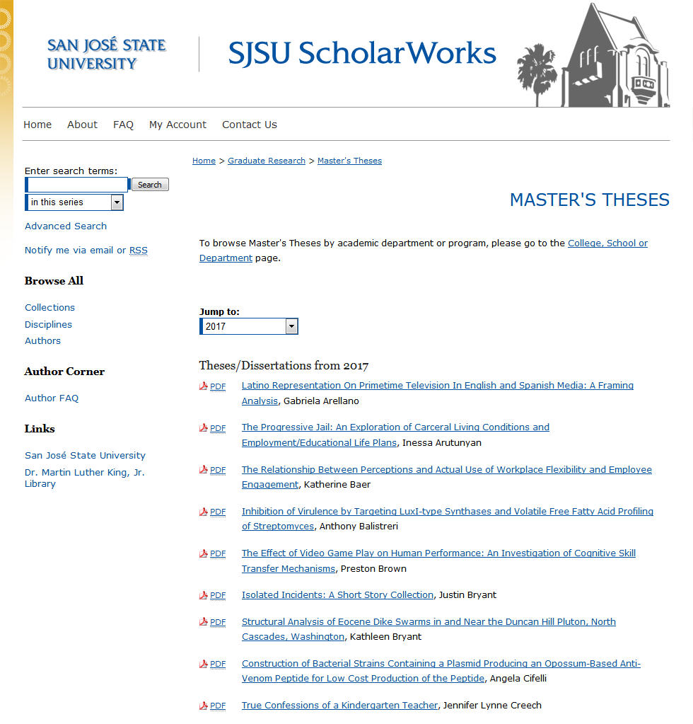
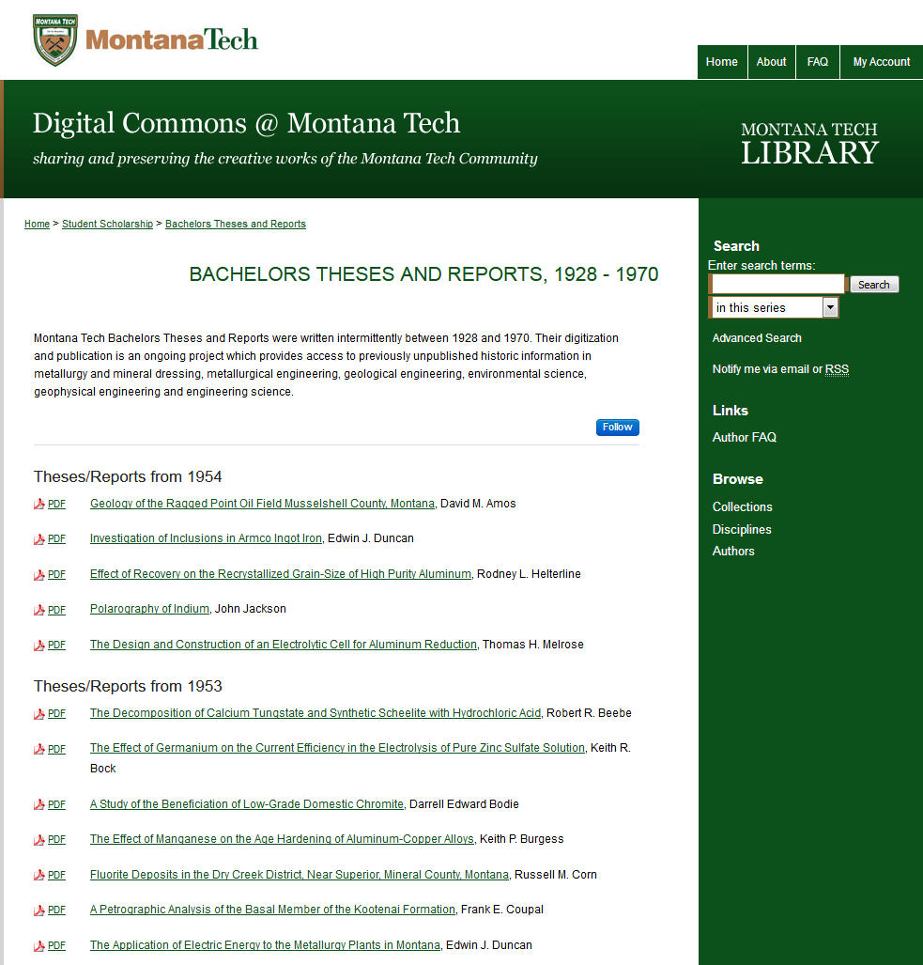
Libraries and ETD management
Libraries as ETD gatekeepers: maintain and transform existing formats

Slide 5
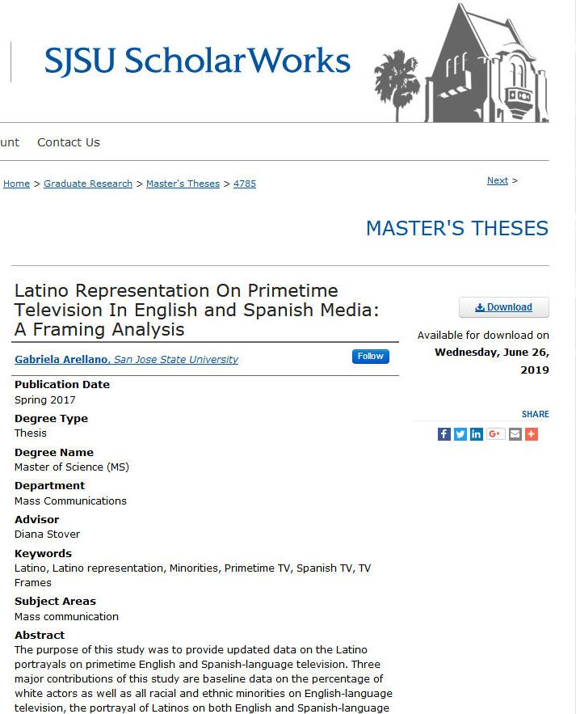
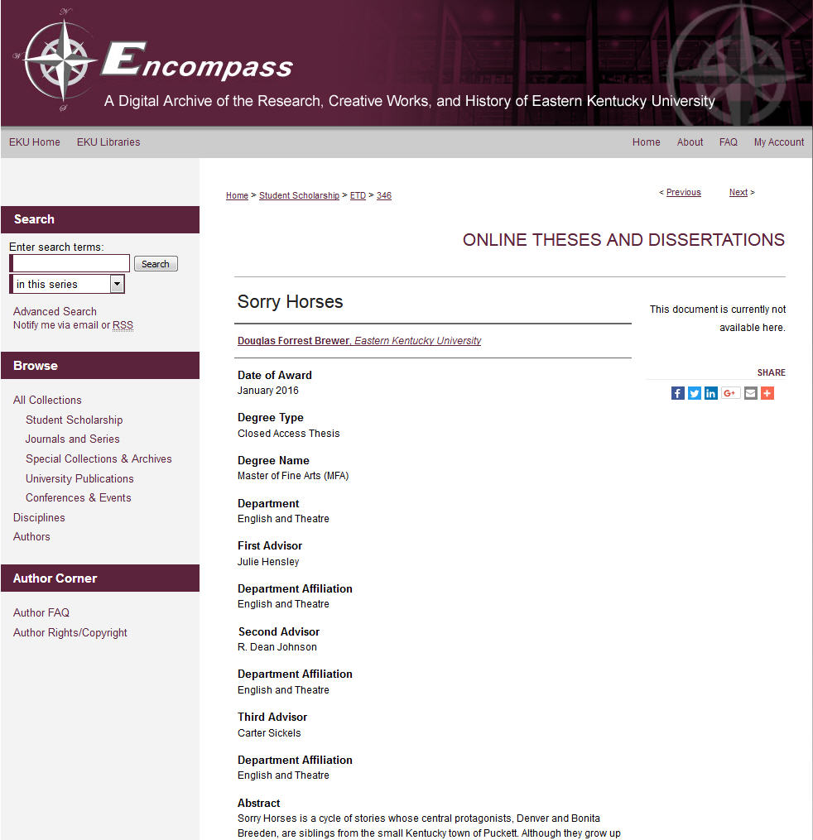
Libraries and ETD management
Libraries as ETD gatekeepers: controlling access to student work

Slide 6
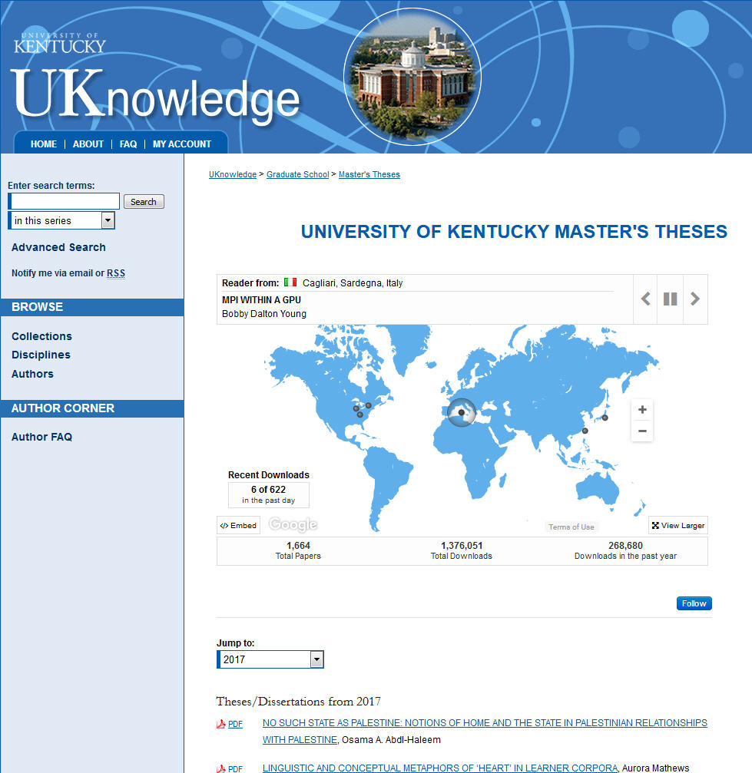
Libraries and ETD management
How many cooks in the ETD kitchen?
Partnering with the graduate division
Determining who has privilege of posting

Slide 7
Organizing your ETD Collection
How do you want to organize your ETDs?
Showcasing the collection vs. showing off departments
Do specific departments have different metadata needs?
What format are your ETDs, do you need to display images or other files?

Slide 8
Organizing your ETD Collection
Entire collection vs. departmental collections

Slide 9
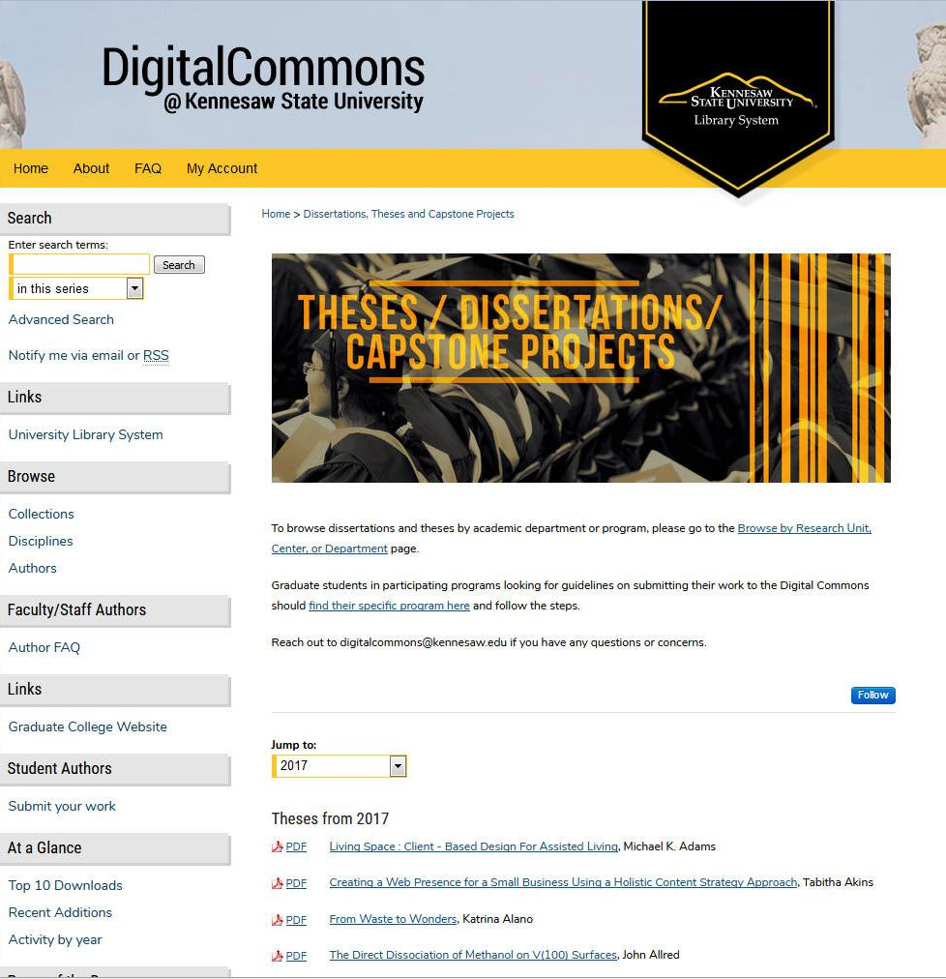
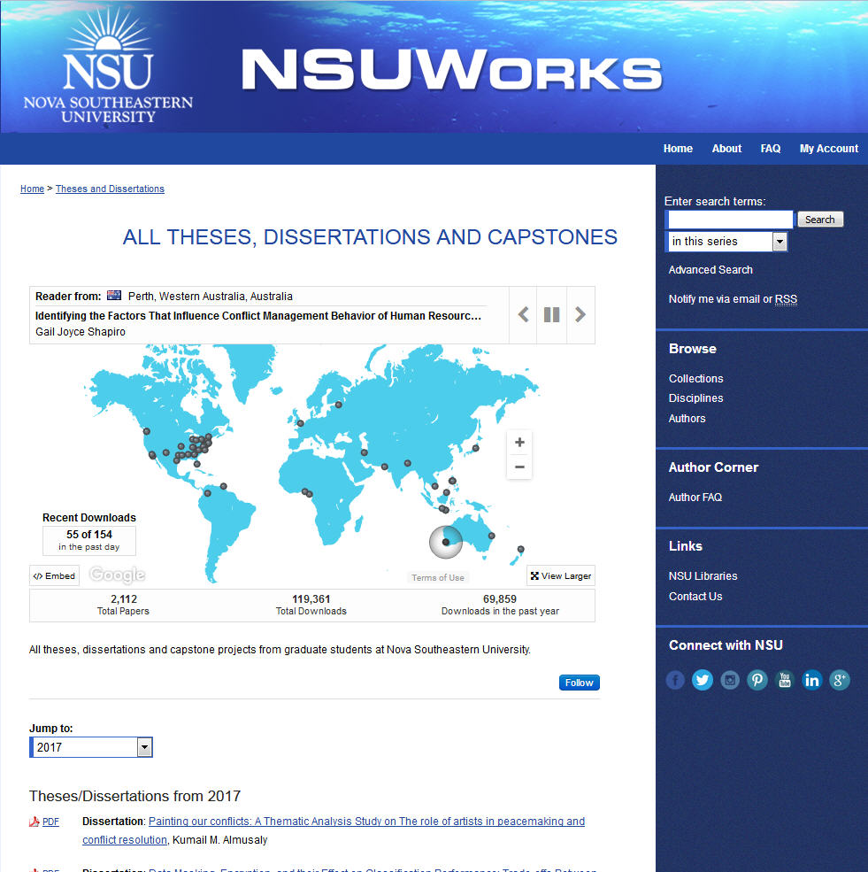
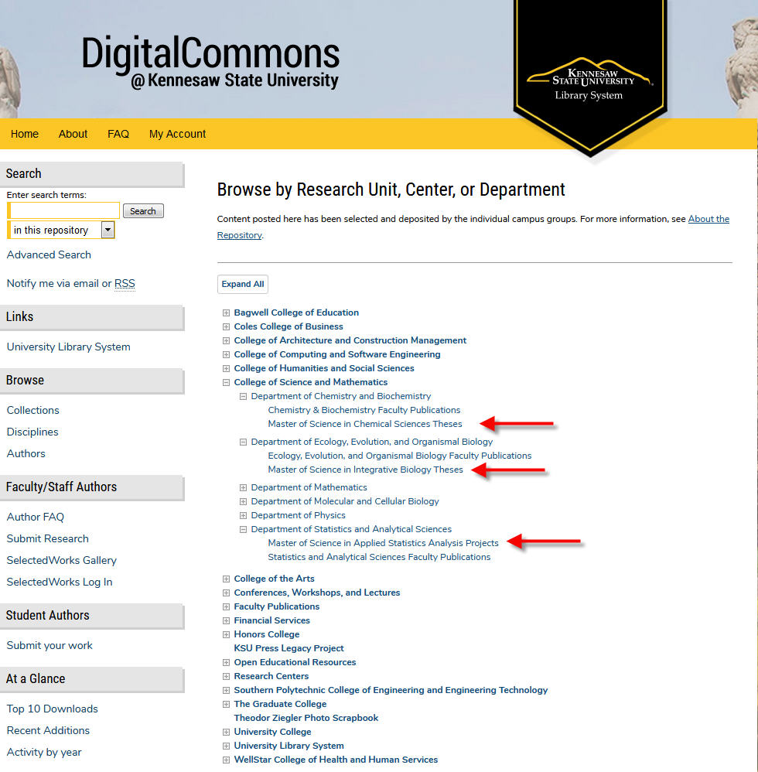
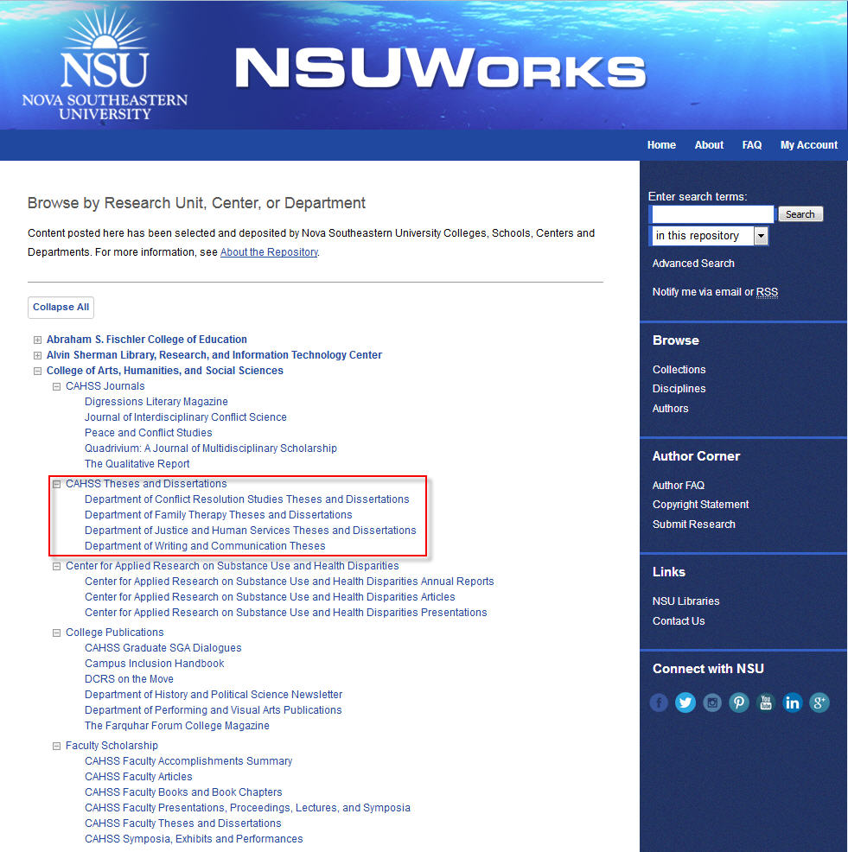
Organizing your ETD Collection
Entire collection vs. departmental collections

Slide 10
Organizing your ETD Collection
Does your desired workflow have an impact on the organization of your collection?
Bulk ingestion -> library posts -> ETDs published
Students submit -> graduate school reviews and posts-> ETDs published
Students submit -> advisors review -> graduate school reviews and posts -> ETDs published

Slide 11
Organizing your ETD Collection
Do different schools, departments, and programs have different metadata needs?
Specific metadata for individual departments
Standardized and consistent metadata across all ETDs

Slide 12
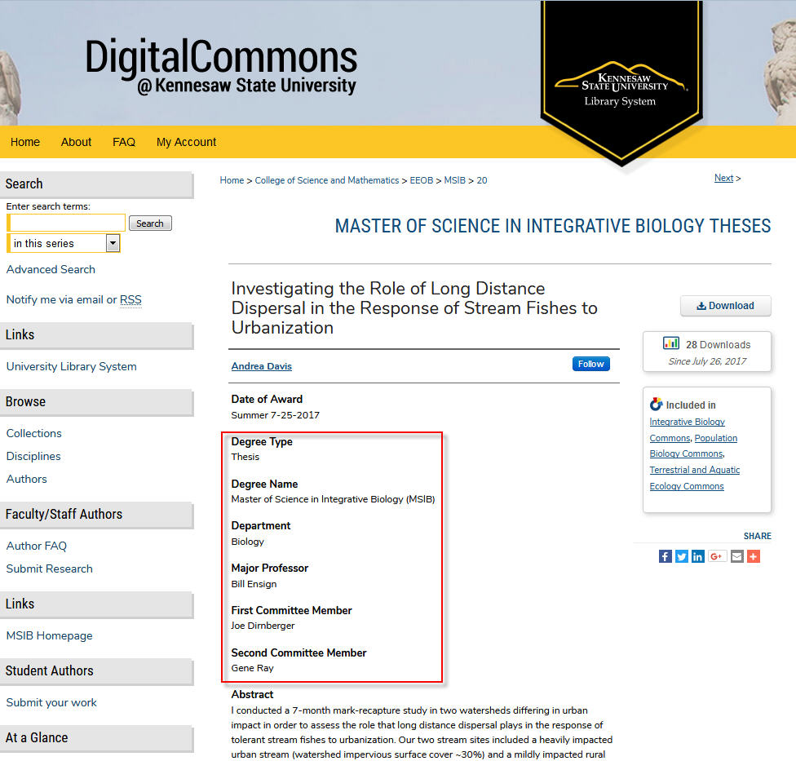
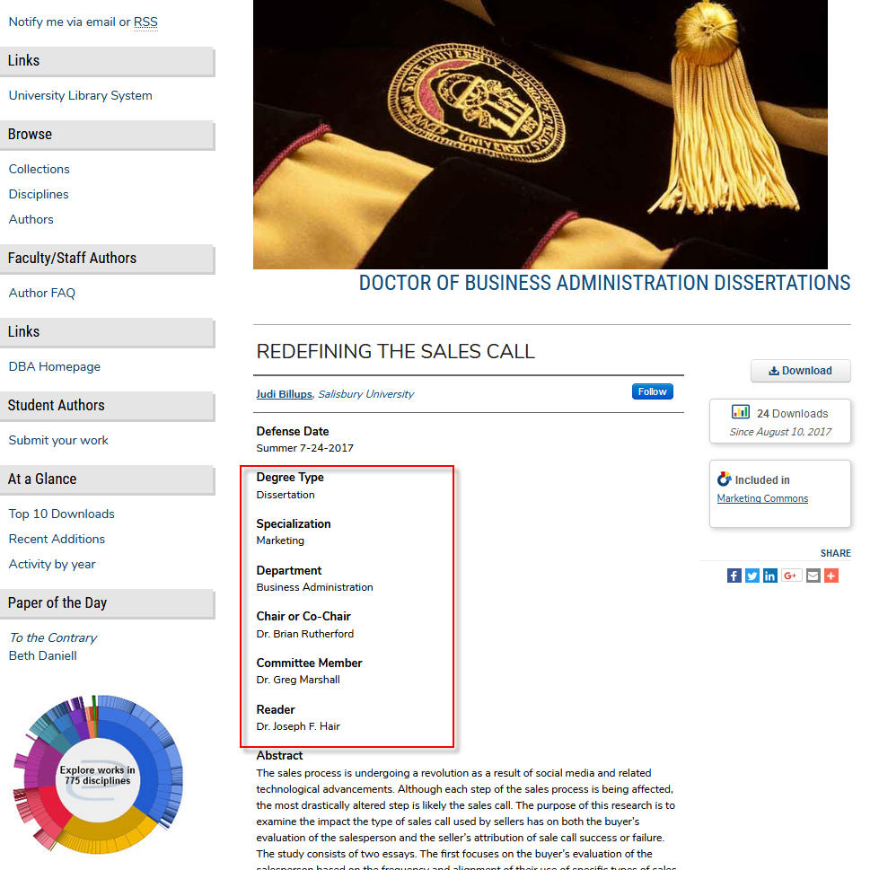
Organizing your ETD Collection

Slide 13
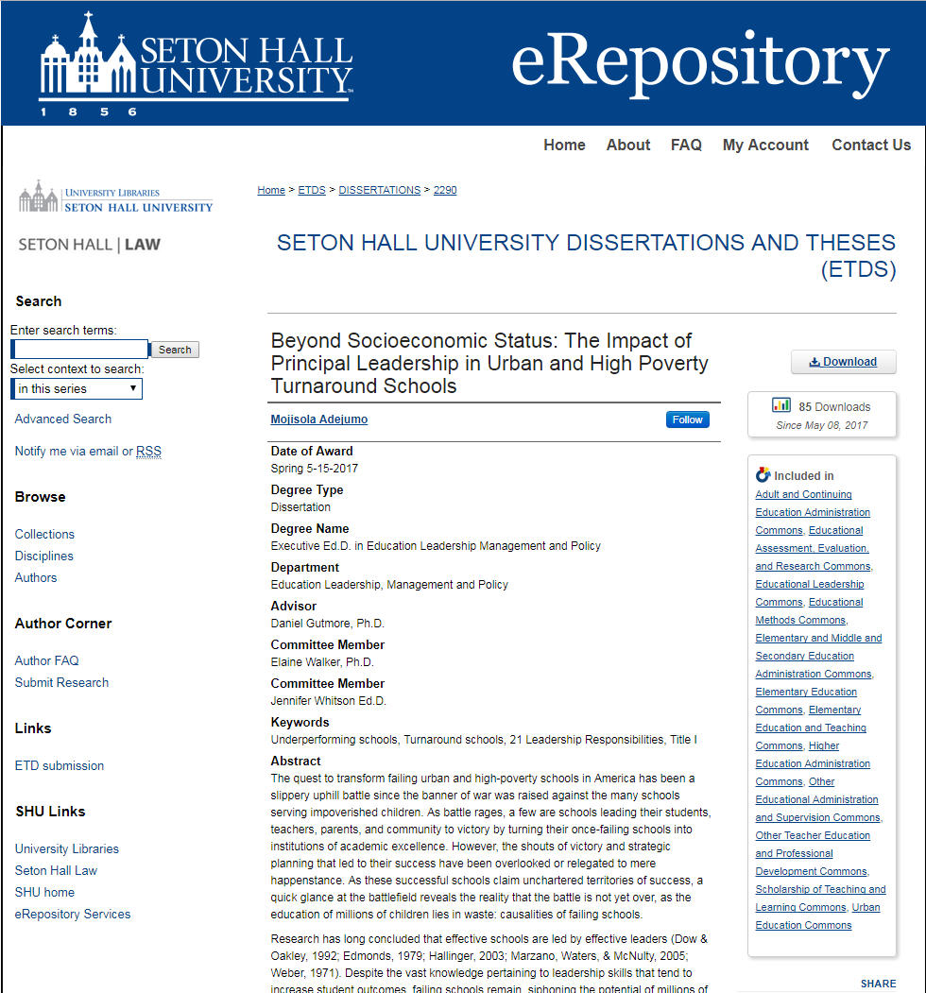
Organizing your ETD Collection
What kind of metadata do you need to collect, and how much of it needs to be public?
Administrative metadata
Public metadata

Slide 14
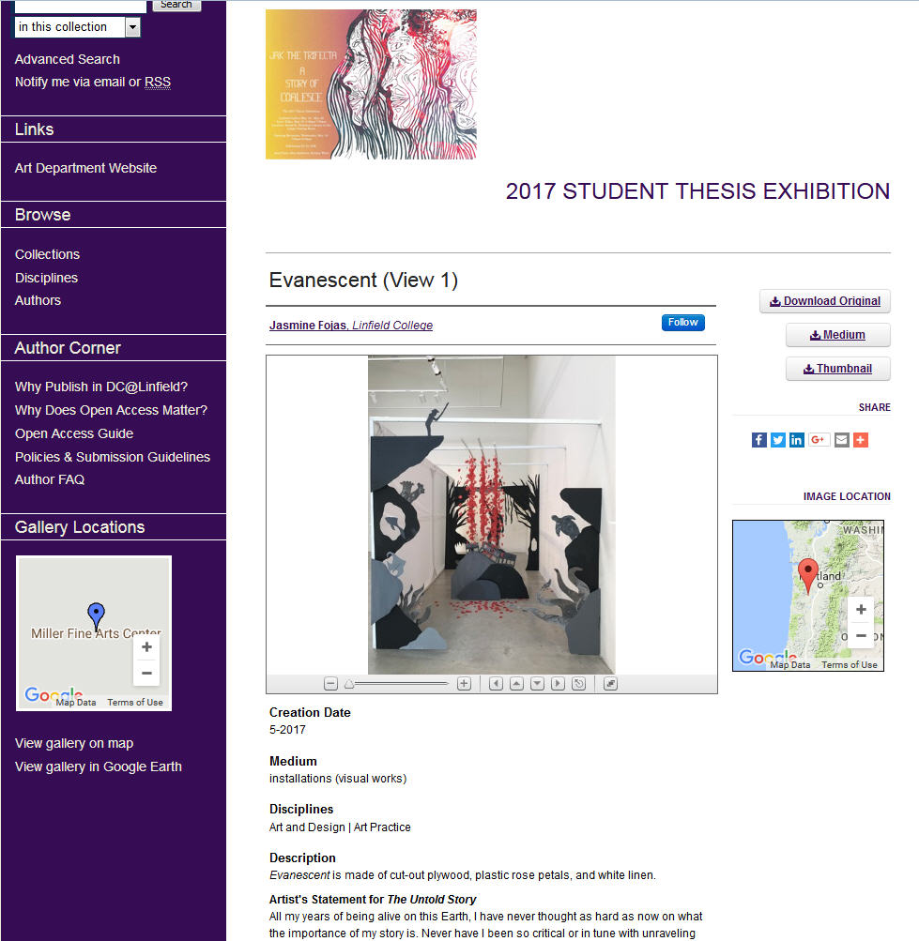
Organizing your ETD Collection
What format are your ETDs - do you need to display images or other files?
Not just for PDFs

Slide 15
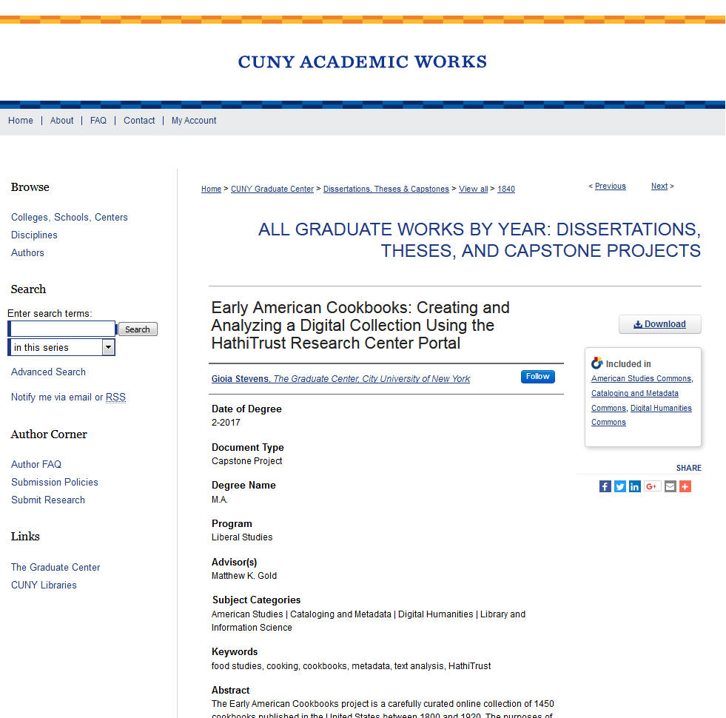
Organizing your ETD Collection
What format are your ETDs - do you need to display images or other files?
Supplemental files

Slide 16
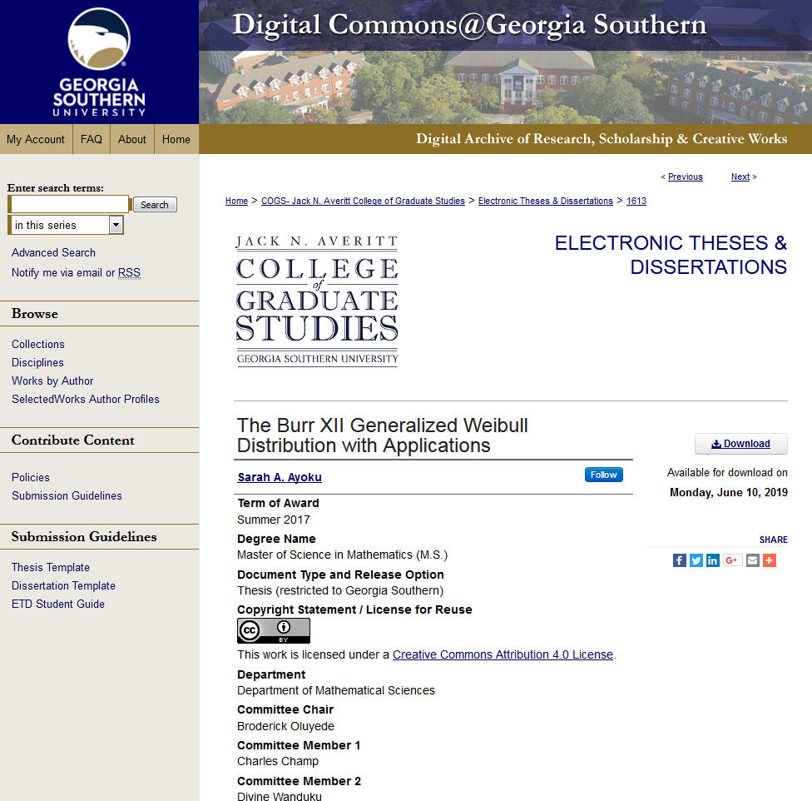
ETDs and Open Access
What concerns might your students and staff have about open access and ETDs?
Posting ETDs enhances discoverability
Access controls and embargoes
Creative Commons licenses

Slide 17
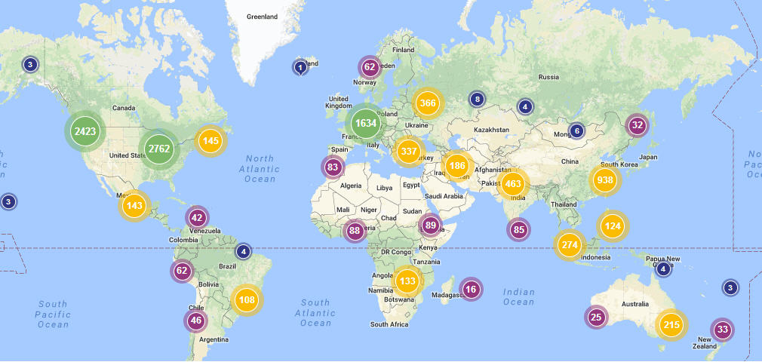
Tracking Discoverability of ETDs
Digital Commons administrator and author dashboards feature download locations/concentrations, and download statistics

Slide 18
Workflows
Butterfly: thesis or dissertation is in its final form
Chrysalis: finalizing of formatting or final approval are needed
Caterpillar: thesis or dissertation is still in the revision process

Slide 19
Butterfly
ETDs are complete and finalized before ingestion to the repository
Print or digital versions have been approved by the graduate department
May include submission to ProQuest
Ingestion process for the library can include scanning printed version, uploading digital version, or receiving a ProQuest XML feed
Little or no direct contact with students or faculty during the process

Slide 20
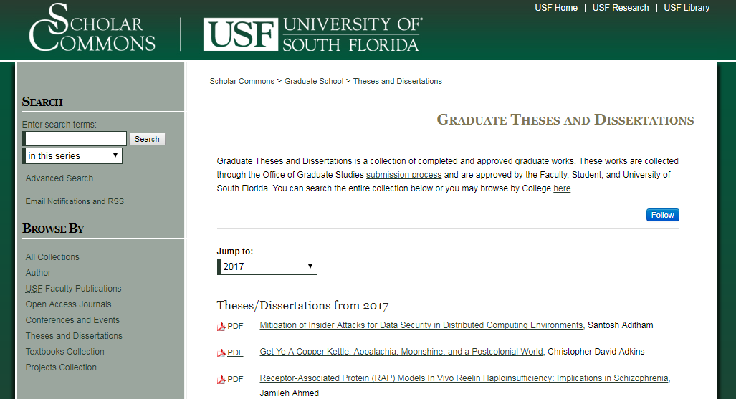
Butterfly - University of South Florida
Drafts circulated in print, with review outside the IR
Students submit to ProQuest
Library receives an XML export from ProQuest
Conversion: Proquest XML → bepress XML
XML uploaded with batch upload

Slide 21
Chrysalis
Students submit the final version of their ETD directly to the repository
Graduate school reviews for metadata/formatting
Customizable submission form means more specific metadata
Graduate school and library involvement
ETDs benefit from Digital Commons SEO, helps discoverability

Slide 22
Chrysalis - University of North Florida
Students submit final version directly to the repository
Graduate school reviews the format and metadata
Grad school administrator uploads signed student agreement and archival version as hidden supplemental content
Grad school administrator publishes the ETD
Digital Commons sends email notification to student

Slide 23
Caterpillar
Students submit ETD to repository, includes advisor information
Admin uses peer review tool to have advisors review the ETD
Grad school or admin can use Register Decision to send acceptance letter
ETD is published

Slide 24
Caterpillar - University of Western Ontario
Student submits a draft of their ETD to the repository
Submission form requires advisor names and email addresses
Graduate school sends a review request to advisors
Advisors use review tool to access ETD and make notes
Student submits revision, which advisors approve or send back for revision
ETD is approved by advisor
Graduate school publishes ETD

Slide 25
Peer Review & ETDs

Slide 26
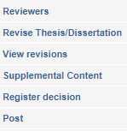
Using peer review tools
Enable through the Configuration page
Peer Review options will be available through the ‘Manage Submissions’ page

Slide 27
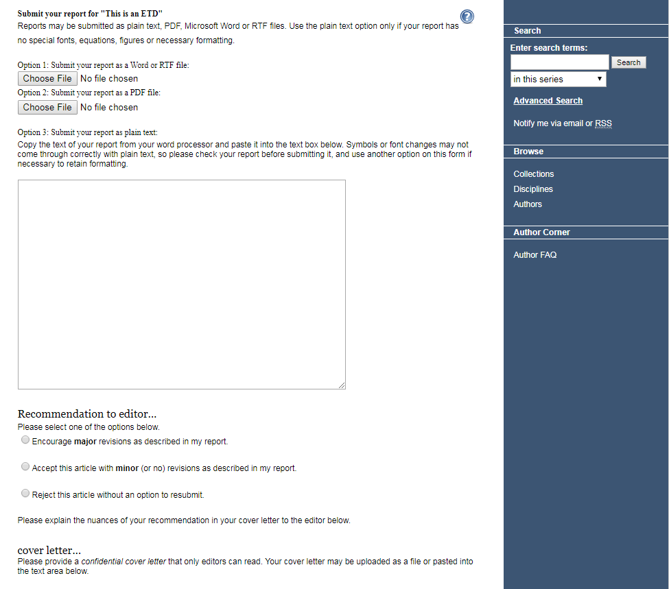
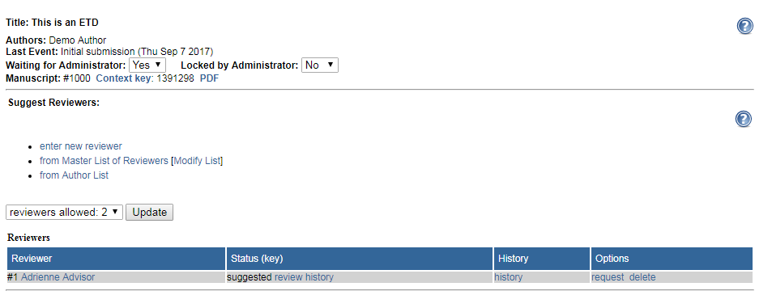
Add advisors as reviewers
Reviewer form text can be customized

Slide 28
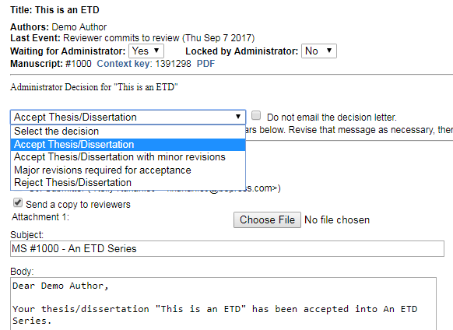
Use ‘Register Decision’ to notify student of their ETD’s status

Slide 29
ETDs in Action!

Slide 31
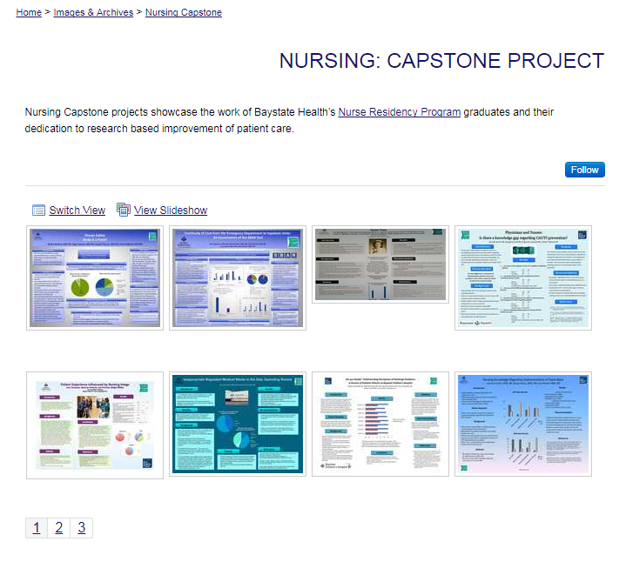
Posters

Slide 32
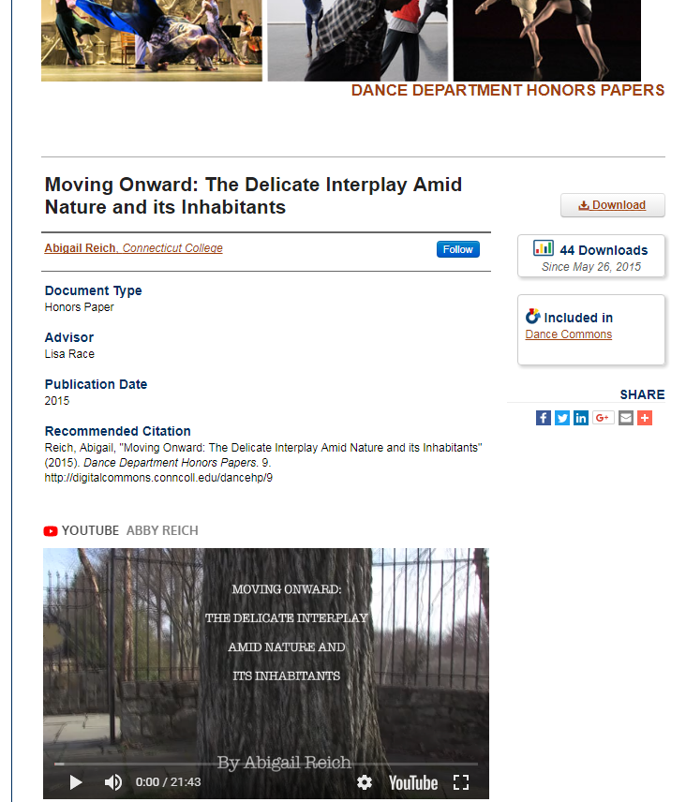
Video

Slide 33
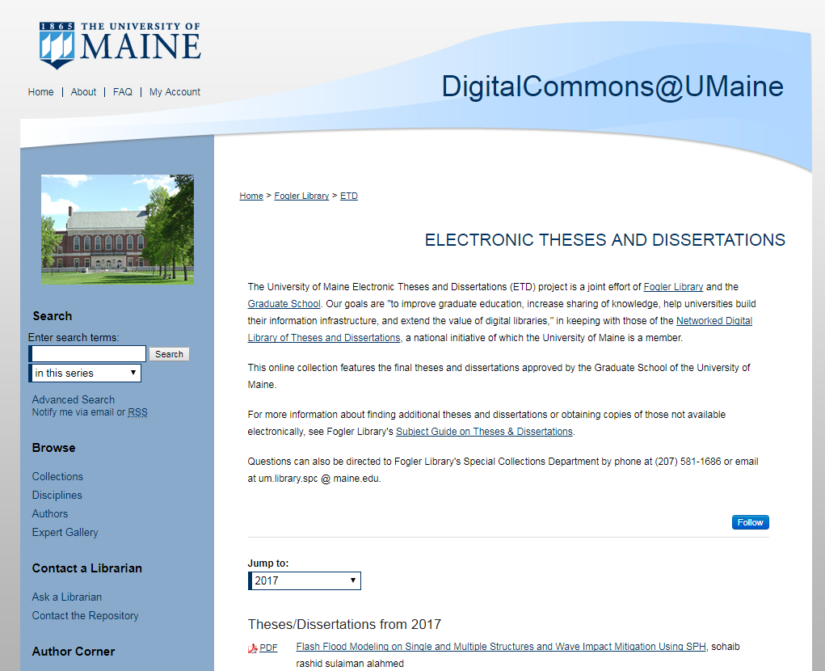
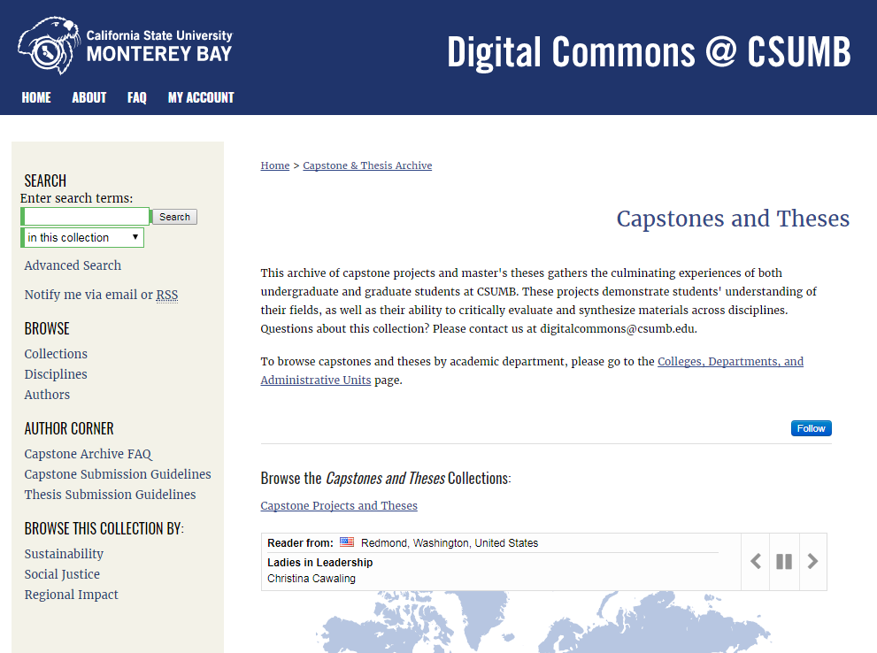
Additional Ideas

Slide 34
Summary
Plan ahead! Decide who will be involved with the ETD collection, how it will be organized, and what your metadata needs are.
Address concerns faculty and students may have about ETDs
Figure out what workflow best suits your library and campus needs
Use Digital Commons reporting tools to examine impact
Consider a wide variety of types of theses, dissertations, and capstone projects

Slide 35
Questions?
Contact consulting services:
510-665-1200, ext 2
dc-support@bepress.com

